Slide 1
MAE Research Project
Multi-Material Topology Optimization
Using Deep Neural Networks.
Anirudh KANTHAMRAJU
14/04/2021

Slide 2
Presentation Overview.
Introduction
State Of the Art
Multi-Material Top-Op Code.
Drawbacks of Existing model for Super Resolution.
Neural Network Model Description
Essential constituents of a Network
Network Layers
Network Architecture
Definition of Loss Function
Training Methodology
Choice of APIs
Constitution of Training Data
Results and Conclusions.

Slide 3
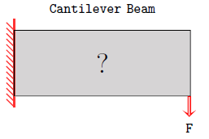

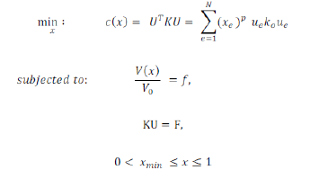
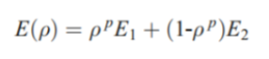
Topology Optimization
Optimal Material Distribution
Loss Function
SIMP

Slide 4
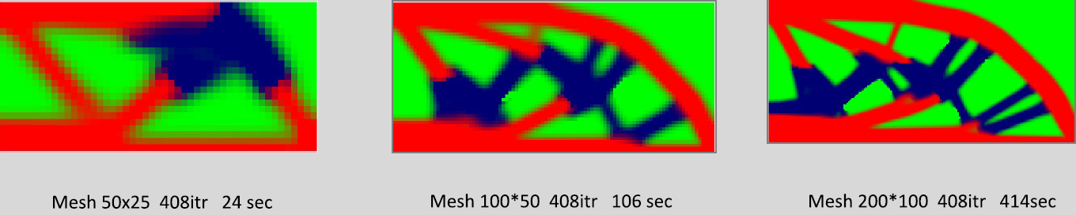
Topology Optimisation

Slide 5

Objective of the Research.
Experience and Intuition
To develop a programme that is able to ‘LEARN’ from ‘EXPERIENCE’ and
‘Intuitively’ predict Topology at a higher resolution from a lower resolution input .

Slide 6

Experience , Intuition and Relevance

Slide 7
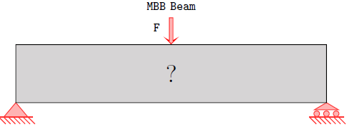

Experience , Intuition and Relevance
Void VF – 50% resolution 80x40

Slide 8

Experience , Intuition and Relevance
Low Mesh Size 40x20
High Mesh Size 80x40
Void VF – 50% E = [ 2,1 ]

Slide 9

Experience , Intuition and Relevance
The End Goal
Train the network on ordered pairs of LR and HR topologies.
It will develop ‘Intuition’ after training.

Slide 10
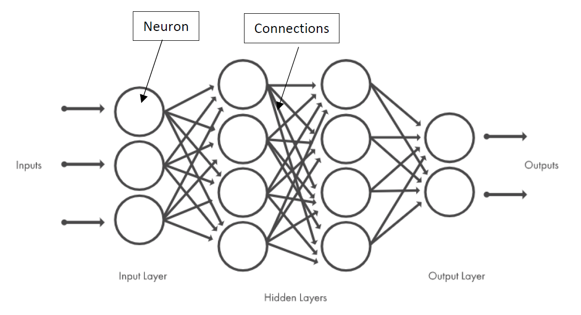
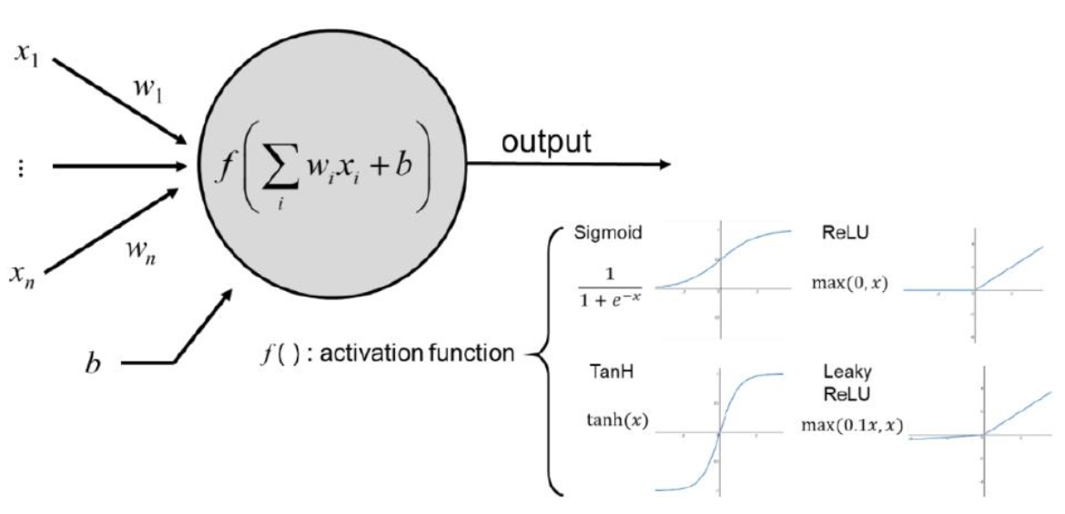
Neural Network Essential Constituents.
Loss Function

Slide 11
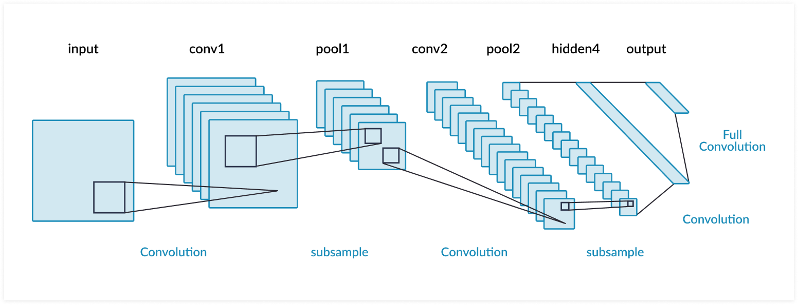

Convolutional Neural Networks (CNNs)
Basic Building Bloc of the research performed.

Slide 12
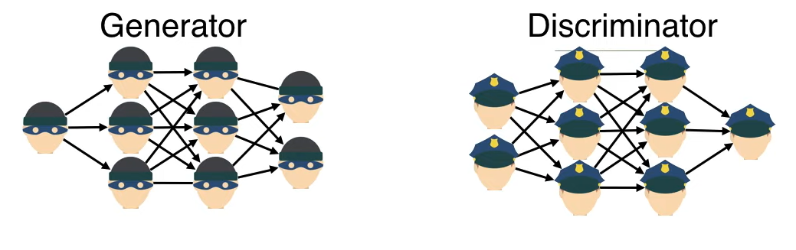
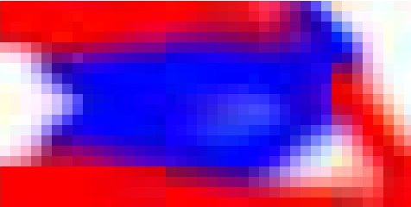
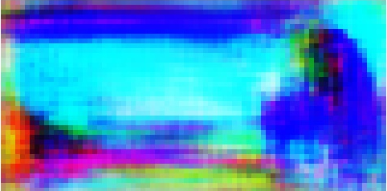
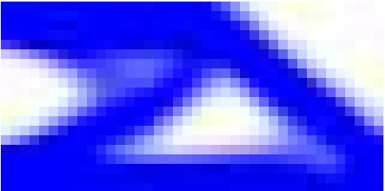
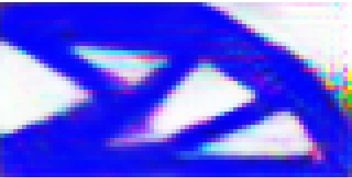
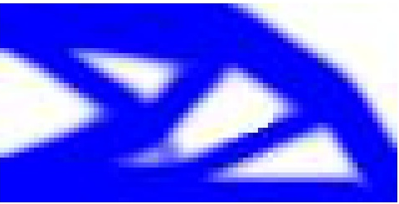
Generative Adversarial Networks.
Not SR
Most Likely SR
This is the true SR o/p

Slide 13

Newer Perspective for the solution.

Slide 14
Newer Perspective for the solution.
Enhance
LR 40x20 i/p
HR 40x20 o/p

Slide 15
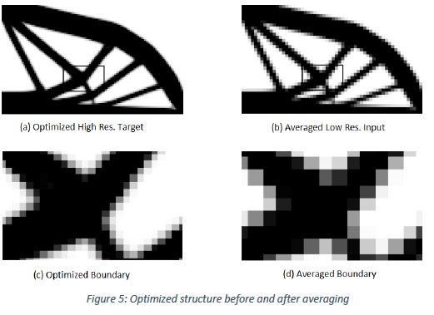
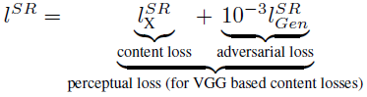
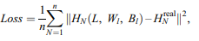
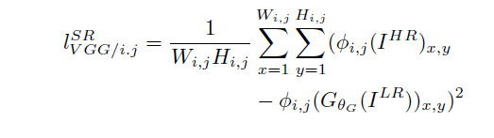
State of the Art – Drawbacks
Nicolas , Huy et al
Pixelwise loss Function
Liang et al

Slide 16
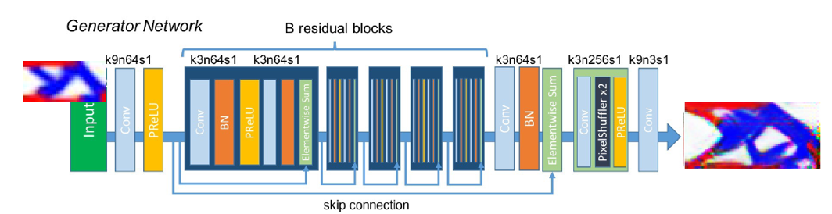
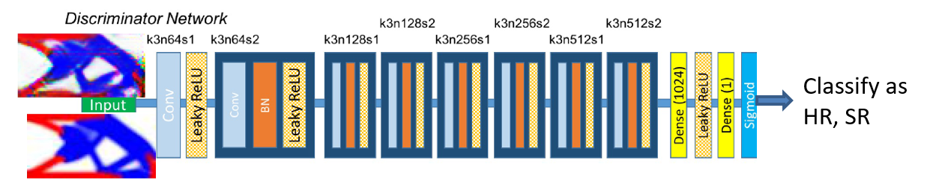
Neural Network Architecture Used.

Slide 17
Data Generation
115-line MATLAB code by Tavakoli and Mohseni to generate optimal topology.
Minimum Compliance Loss function.
Void Volume fraction [ 0.2 : 0.01 : 0.5]
Data with up to 3 materials.
Ratio of Youngs Modulus 3:2:1
Material distribution ratios.
3 Materials
1:01:01 | 2:01:01 | 3:01:01
1:01:02 | 2:01:02 | 3:01:02
1:01:03 | 2:01:03 | 3:01:03
1:02:01 | 2:02:01 | 3:02:01
1:02:02 | 2:02:03 | 3:02:02
1:02:03 | 2:03:01 | 3:02:03
1:03:01 | 2:03:02 | 3:03:01
1:03:02 | 2:03:03 | 2:03:02
1:03:03
1 Material
1
2 Material
1:01 | 2:01 | 3:01
1:02 | 2:03 | 3:02
1:03
From all possible combinations ( total 589 sample i/p data points)
250 equi-spaced points were selected for data generation.

Slide 18
Training and Validation Data
80% of Total Data
20% of
Total data
No intersection between
Training and validation data

Slide 19
Coding Environment. Training Architecture.
Python – 3.8.8
Tensorflow – 2.4.1
Nvidia GUP

Slide 20
Results and Conclusions.
3 Experiments performed
Experiment 1 – Cantiliver BC Input Img 40x20 Output Image 80x40 5000 Epochs
Experiment 2 – Cantiliver BC Input Img 100x50 Output Image 200x100 5000 Epochs
Experiment 3 – Cantiliver and MBB BC Input Image 40x20 Output Image 80x40 6000 Epochs.

Slide 21
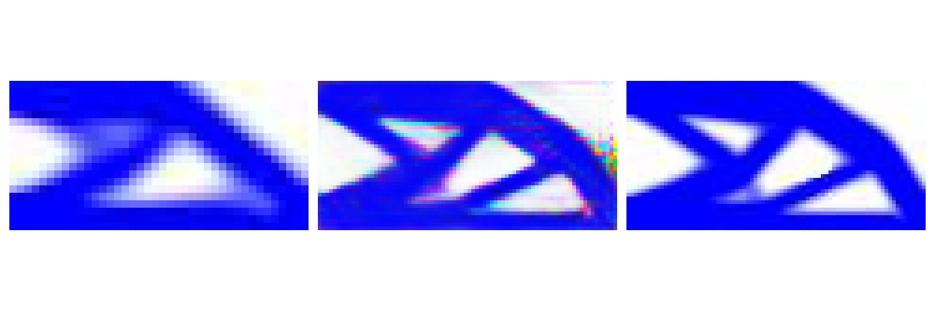

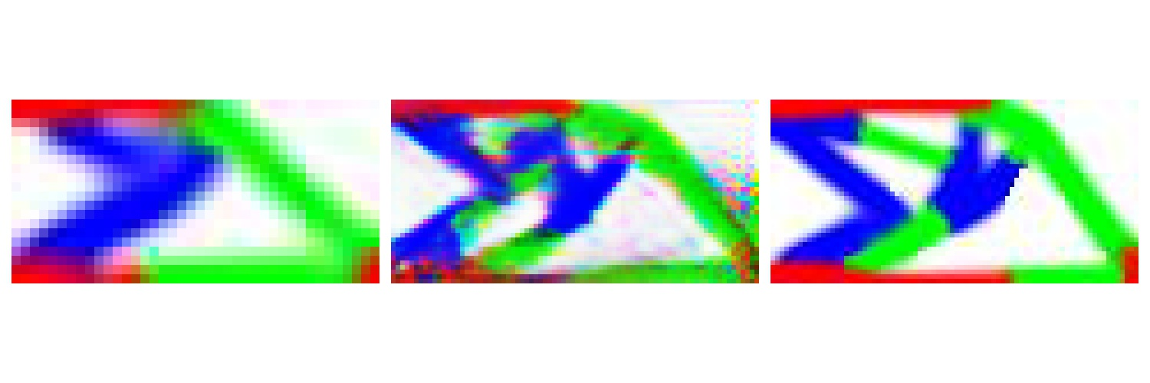
Results and Conclusions. EXP 1
Prediction time ~ 35 sec*
Training time 22hrs*

Slide 22



Results and Conclusions. EXP 2
Prediction time ~ 65 sec*
Training time 24hrs

Slide 23
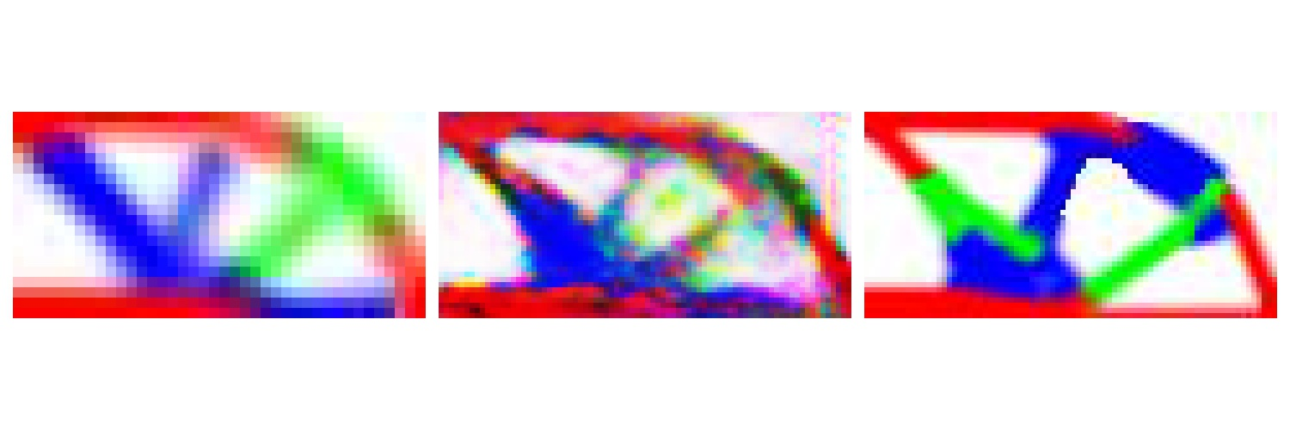
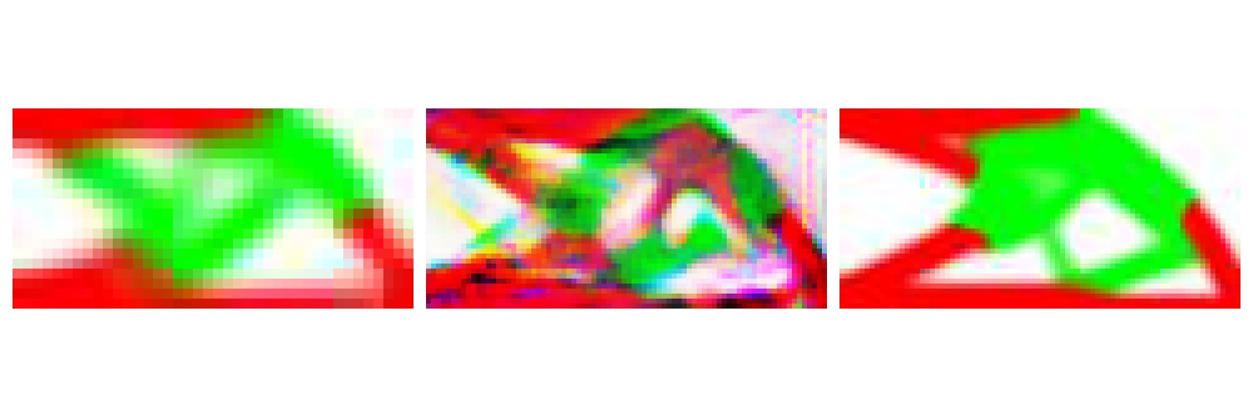
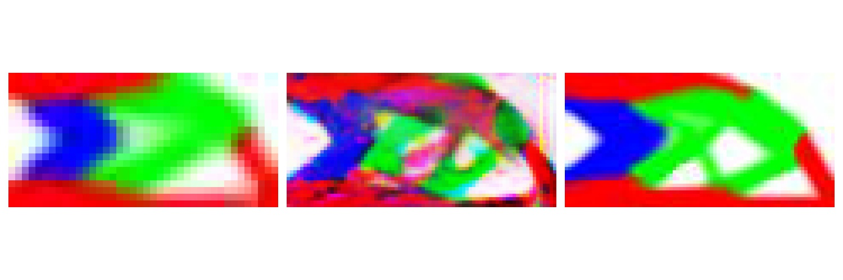
Results and Conclusions. EXP 3
Trained with 502 images
For 6000 epochs.
The noise can be because
Of larger dataset.
Training time 30 hrs.

Slide 24
Results and Conclusions.
The global objective of prediction time has been significantly reduced.
Proves the influence of Loss functions in bridging the gap between the predicted and true topologies.
Integration into algorithms using genetic algorithms for predicting topologies is feasible.
Establishes a solid foundation for future works and proves the Network Architecture’s capability.
Application of the research.
In softwares like AutoDesk 360 which already uses genetic algorithms for prediction of optimal topologies.
As an add on to FEM- AI oriented softwares like that of Monolith AI.
Integration into existing research codes.

Slide 25
Future Works
Integration of a compliance predictor to the loss function.
A reverse engineered FEM code to predict the compliance from image input.
Higher Accuracy
Longer Training times. ( Will be a computation heavy iterative solver )
Another neural network to predict the compliance.
Slightly lower accuracy. ( The performance of the network is dependent on architecture and training data)
Shorter training time.
More Experiments with different kernel sizes and strides to study their influence.
Integration of a FEM o/p as a part of the input layer. (Numpy Arrays support color channels. One of them could be FEM data with stress fields and displacement vectors for end user application. )
Development of FEM codes to validate the accuracy of the model. (VGG loss is not an acceptable metric for engineering applications)

Slide 26
Salutations.
Firstly, to Prof Morlier who was always supportive.
Mr. Vilas Raj and Mr. Edouard who have helped me in understanding the basics of SIMP
Mr. Julien Pedron who was kind enough to teach me how to setup and run my training models on the HPC.
Mr. Anand Vidvat and Mr. Gaganpreet singh ( doctoral candidate ISAE ) for help in handelling some deprecated functions in the DNN code.
To Dr. Annapoorna ( Prof VIT university – AI Researcher) who taught me the fundamentals of programming
To all the coffee producers in the world supplying essential fuel to conduct my research.

Slide 27
References.
An Artificial Neural Network Approach to Generating High-Resolution Designs from Low-Resolution Input in Topology Optimization ( Nicolas Napier et al )
Shape related constraints aware generation of Mechanical Designs through Deep Convolutional GAN (Dimitri et al)
Efficient, high-resolution topology optimization method based on convolutional neural networks ( liang et al)

Slide 28
Git Hub Reposotory
https://github.com/Anirudh-Kanthamraju/Multi-Material-Topology-Optimisation

Slide 29


